Slide 1

LE Analytics
A Software Pipeline and Web Platform for the Analysis of Microbial Genomic Data from Adaptive Laboratory Evolution Experiments
Patrick Phaneuf
CSE MS Defense
November 2016
Notes:
I’m going to present to you my Computer Science Master’s thesis work I’ve been building since Fall 2014.
I came to UCSD through the MS CSE program and quickly became infatuated by the bioinformatic and systems biology work being done here; so I got involved with projects in this domain as soon possible.
The work I’m going to describe is about a live system that I’ve built to solve a particular set of problems that UCSD’s Systems Biology Research Group was experiencing in analyzing their experimental evolutions.
This MS work has ultimately resulted in the opportunity to continue in the BISB program, and for that I am very thankful.
The official title of this MS thesis is “ALE Analytics: A Software Pipeline and Web Platform for the Analysis of Microbial Genomic Data from Adaptive Laboratory Evolution Experiments”

Slide 2
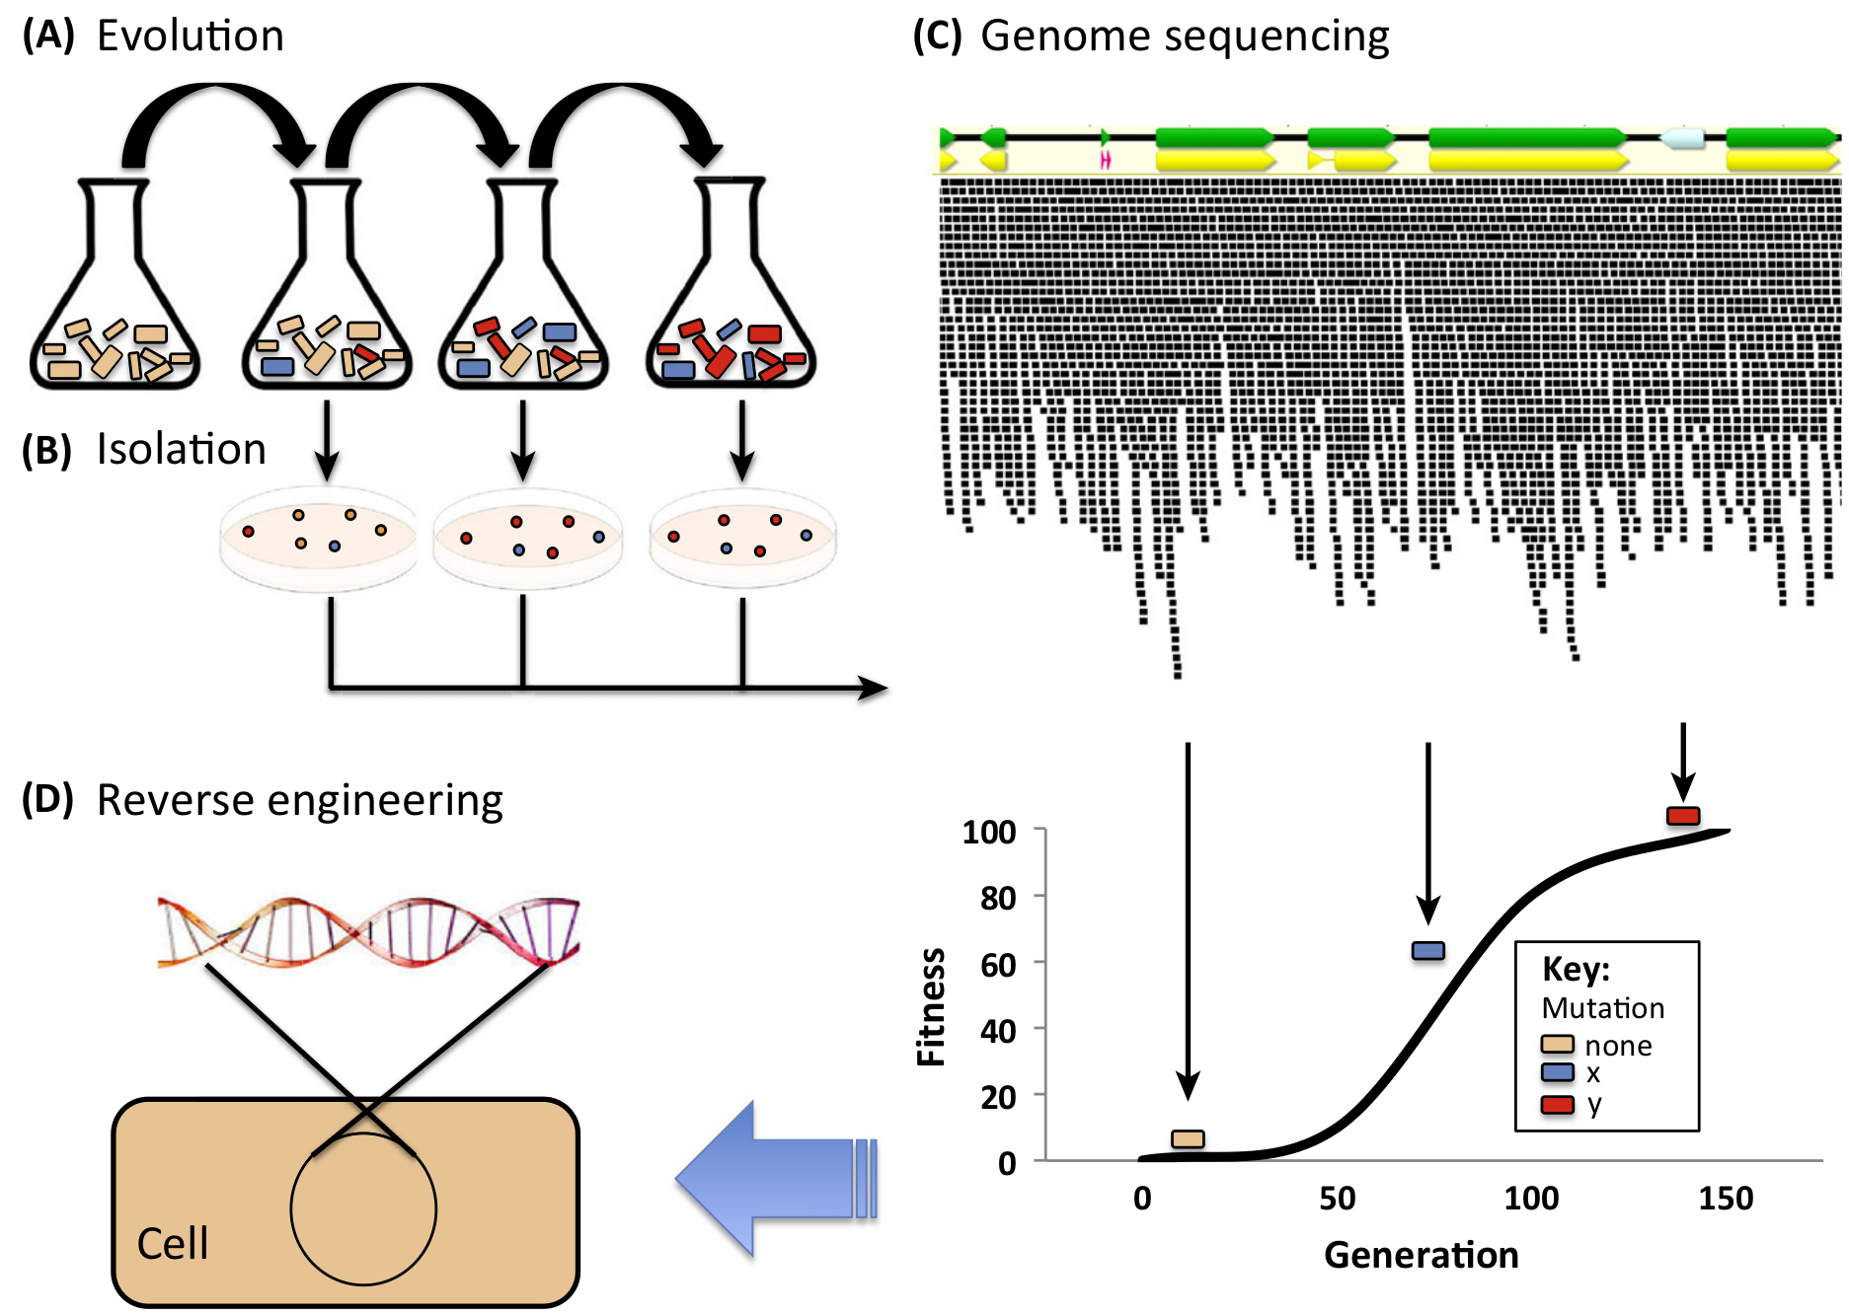

Background: ALE Experiment Processing
ALE
Williams et al., Trends in Biotech May 2016
Notes:
Two key points in the title I’ll first give some background on are:
Adaptive Laboratory Evolution Experiments
Microbial Genomic Data
Adaptive Laboratory Evolution (or A-L-E “ALE”) Experiments can be described as experimental evolutions, where you
Isolate an organism of interest in a controlled environment and enable it to grow for multiple generations.
This series of flasks represents a chronologically ordered set of samples that ultimately describe an experimental evolution NEXT
You then investigate for mutations that manifest in the evolved samples with regards to a reference genome
This is where the Microbial Genomic Data plays its role. NEXT
You then associate these mutations to observed phenotypic changes with your sample to find SIGNIFICANT MUTATIONS.
This is often accomplished by investigating all mutations found to manifest during a phase of accelerated sample population growth. NEXT
Finally, you investigate the mechanistic effects that these KEY MUTATIONS have on their host.
Experimentalists additionally may be interested in introducing particular stresses on the organism during the experiment in the hopes of observing adaptive mutations as a result of the stress.
ALE experiments can therefore be used to identify mutations that are beneficial WRT to experimental conditions.

Slide 3

Background: ALE Machine
ALE Experiment
Less human intervention.
ALE 1
Expand the scale of ALE experiments through automation.
ALE 2
More consistent results.
ALE 3
Incorporate previously infeasible parameters.
LaCroix, Automation, Optimization, and Characterization of Adaptive Laboratory Evolution 2016
Notes:
The Systems Biology Research Group here has OPTIMIZED their ALE experiment operations through automation. They’ve built an ALE Machine that executes ALE experiments with much less human intervention.
The ALE Machine has allowed them to:
Expand the scale of their ALE experiments.
It also enables more consistent results through automation. NEXT
Finally, the ALE machine enables experimentalists to incorporate previously infeasible parameters into their ALE experiments.
These parameters were often infeasible due to the work schedule involved in executing them.
This increased scale of the ALE experiments has translated to increased scale of result sets.
In summary, the ALE Machine enables consistent, high-through ALE experiments with a more diverse set of parameters.

Slide 4
Big Data
Post-Processing
Chal 1
Data Consolidation and Reporting
Chal 2
Result Accessibility
Chal 3
Analysis Effort, Accuracy and Consistency
Chal 4
Knowledge
Margolis et al., Journal of American Medical Informatics November 2014
Notes:
The larger scale ALE experiments enabled by the ALE Machine’s automation exacerbates existing challenges and introduces new challenges. In biomedical fields, issues in analyzing experiment results due to the increased scale of data is generally described as a Big Data to Knowledge problem, and in our case, is described by 4 main challenges.
CLICK For Challenge 1
We need to define a workflow and toolset that takes as input VAST AMOUNTS sequencing reads and outputs mutation reports with low noise levels.
~This summarizes the challenge of building a post-processing protocol.
CLICK For Challenge 2
As the scale of an ALE experiment grows, so too does the effort necessary to curate reports on the experiment results.
~This summarizes the challenge of data consolidation and reporting.
CLICK For Challenge 3
ALE experiments involve multiple collaborators.
The logistics of sharing results can be challenging between local collaborators and even more problematic between remote collaborators.
~This summarizes the challenge of result accessibility.
CLICK For Challenge 4
The effort of analysis and the potential for human error also scales with the size of the experiment.
Analysis protocols between investigators may be inconsistent, therefore making the comparison of results between different ALE experiments more difficult.
~This summarizes the challenge of analysis effort, accuracy and consistency.

Slide 5
Big Data
Aim I
Post-Processing
Establish a Post-Processing Protocol
Chal 1
Automate Data Consolidation and Accessible Report Generation
Data Consolidation and Reporting
Chal 2
Aim II
Result Accessibility
Chal 3
Aim III
Analysis Effort, Accuracy and Consistency
Automate Common Analysis
Chal 4
Knowledge
Margolis et al., Journal of American Medical Informatics November 2014
Notes:
The work of my thesis focuses on implement solutions to each of these challenges.
The following are the aims of this thesis.
CLICK
We aim to create a post-processing protocol that will take in ALE experiment sequencing data and produces mutation data in which we have high confidence in.
CLICK
To reduce the effort in generating ALE experiment reports, we develop software to automate the parsing and databasing of ALE experiment results.
We will then leverage this database with a reporting application that auto-generates the ALE Experiment reports.
To address the challenge of results accessibility, the application used to generate ALE experiment reports will be developed as a web app which can be made accessible to all collaborators over the web.
CLICK
Leveraging the experiment database and web platform, we automate common ALE analyses to provide solutions to the challenges of effort, accuracy and consistency of analysis.
This work therefore describes these challenges and the culmination of their resolutions as an ALE Big Data to Knowledge solution.
The many methods of identifying an ALE experiment's key mutations will be defined and automated; their results will be presented by the reporting features alongside the mutation lineage reports.
We need to find a toolset that is well enough established and supported for identifying mutations between the reads of a bacterial sample and a bacterial reference genome.
We also need to be aware of the quality of our sequence data and therefore need to establish and leverage a set of tools to describe and refine our sequencing data’s quality.

Slide 6
Big Data
Aim I
Global Quality Control
Establish a Post-Processing Protocol
Automate Data Consolidation and Accessible Report Generation
Aim II
Aim III
Analysis Effort, Consistency and Accuracy
Automate Common Analysis
Knowledge
Notes:
We’ll review the Aim 1, which focuses on establishing a
TOOLSET
and WORKFLOW
to impose quality control
and generate mutation predictions
on the raw sequencing data produced from ALE Experiments.

Slide 7

Aim I: Motivation and Workflow
Resequencing
: Breseq³
Sample 1 Mutation 1 Mutation 2 Mutation 3 Mutation 4 Mutation 5
Sample 2 Mutation 1 Mutation 2 Mutation 3 Mutation 4
Sample 1 Mutation 1 Mutation 2 Mutation 3 Mutation 4 Mutation 5 Mutation 6 Mutation 7 Mutation 8 Mutation 9
Sample 2 Mutation 1 Mutation 2 Mutation 3 Mutation 4 Mutation 5 Mutation 6 Mutation 7 Mutation 8 Mutation 9
Refine Sequencing Data
(3) Barrick et al. Methods Mol. Biol, 2014.
Notes:
Given sequencing data on their samples, experimentalists align their reads against a reference genome to get the set of mutations from their evolved samples in an ALE.
NEXT
This task is often referred to as RESEQUENCING.
There exist many tools that accomplish this. We’ve currently settled on using the BRESEQ software for this task.
NEXT
In practice, you can’t always simply resequence your RAW reads to get the meaningful mutation data on your samples. You may find that your resequence generates too many mutations artifacts to process, likely due to low quality artifacts.
NEXT
We therefore need a solution to refine the raw sequencing data and remove any poor quality artifacts to hopefully get more manageable set of mutation for an ALE experiment.

Slide 8
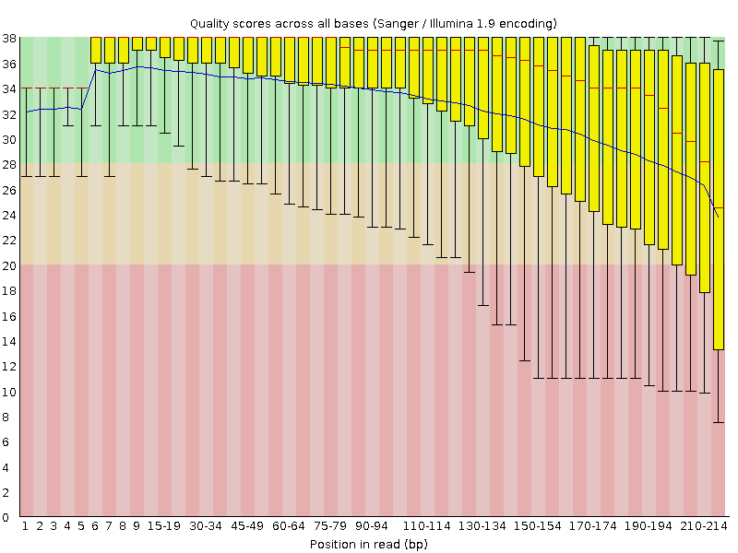
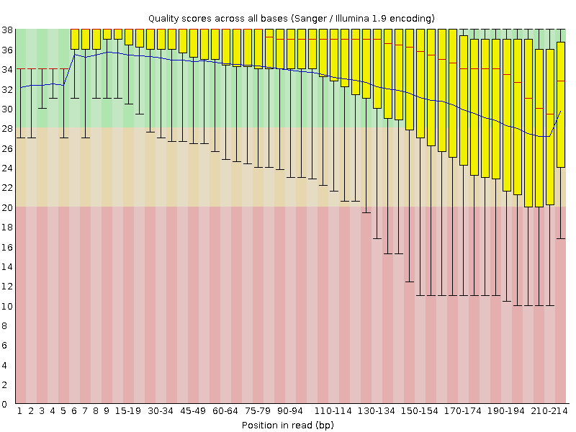
Aim I: Workflow
Read Quality Reporting: FastQC¹
Read Quality Trimming: FASTX-Toolkit²
Base Call Quality ⇒ Q-Score
Great Quality
Q-Score Trimming
Good Quality
Bad Quality
Q-Score per bin of base calls on reads.
(1) S. Andrews. Fastqc: a quality control tool for high throughput sequence data, 2010.
(2) Hannon Lab. FASTX Toolkit.
Notes:
We use the FASTQC software to report on the quality of our reads.
In our research, we’ve found that the Q-scores given to each base call by the sequencer are the most obvious indicators read quality.
With FASTQC, we can observe the cumulative Q-scores for all positions within a set reads. From this, we judge whether the reads could be refined by trimming off bases that have low Q-scores from theirs ends.
NEXT
We trim the low quality ends of the reads using the FASTX-Toolkit software.
With this trimming, you can see that we can raise the average Q-score for the bases at the ends of our reads above the low quality threshold.
This quality trimming can result in less mutations being called during resequencing.
Normally, the majority of the raw data refinements occurs when trimming and filtering to remove artifacts that might result in inappropriate mutations that would be called during alignment.
Currently, the common quality artifacts we investigate and trim for are low quality bases and the biasing of bases in reads.

Slide 9
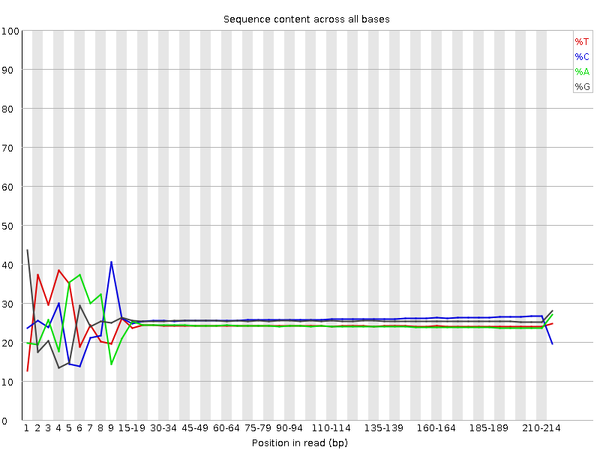
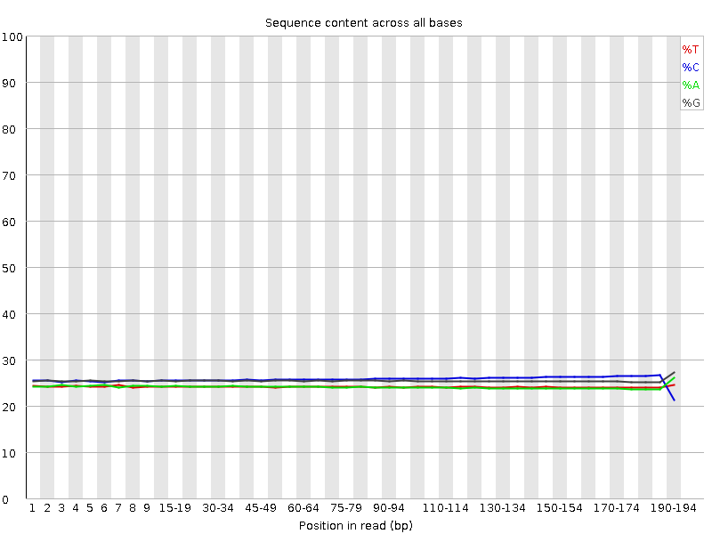
Aim I: Workflow
Base Bias
No Bias
Base Bias Trimming
Per base sequence content for all positions within a read.
Notes:
In some sample sets, we experienced a high frequency of mutations that manifested on the ends of reads with SNPS of high Q-scores. Investigating the FastQC quality reporting, we are shown that our reads seem to express a bias of certain BASES on their ends.
This type of bias has been known to manifest with chemistry based shearing of an entire genome into smaller pieces.
NEXT
We therefore investigated trimming this bias and in some cases this helped.

Slide 10
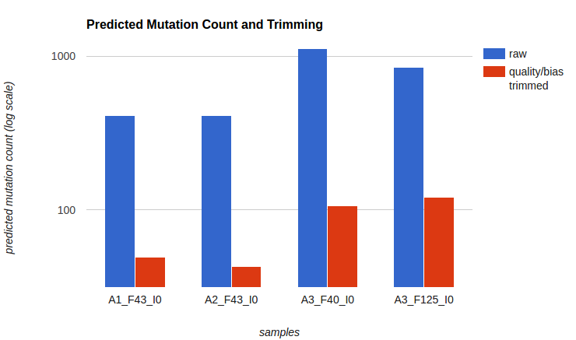
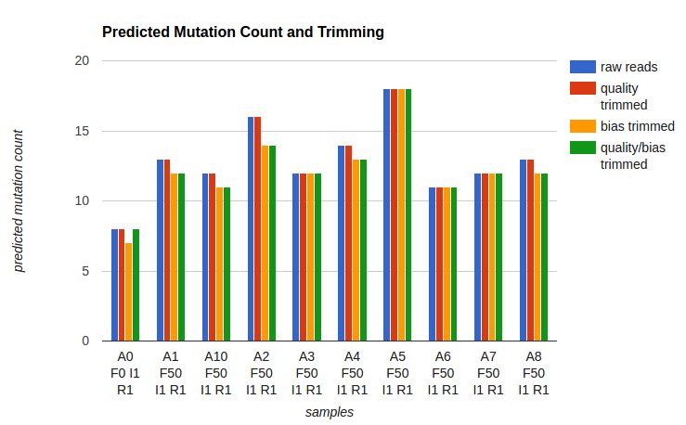
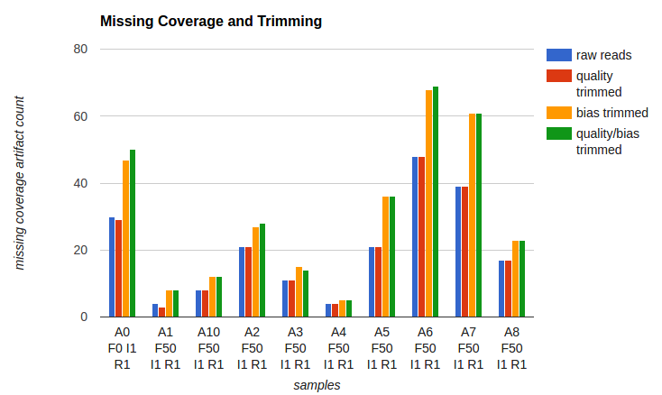
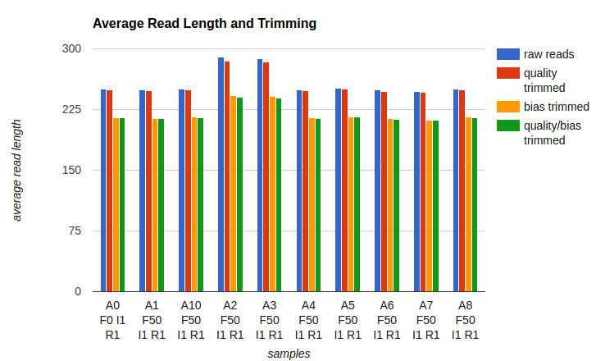
Aim I: Case Studies (Results)
Experiment 1
Experiment 2
Notes:
For one of our experiments, removing the bias from the ends of reads resulted an order of magnitude less mutations for many samples.
NEXT
Though, upon further investigation in applying bias trimming to many more experiments, we actually see that bias trimming isn’t always effective and can in fact lead to more mutation artifacts.
Here we see that bias trimming did lead to less mutations, though it also lead to many more missing coverage areas being called in the resequencing.
This may be due TO the shorter average read lengths as a results of trimming.
These case studies show that trimming should be used on a case-by-case basis, leveraging both the FASTQC quality reports and the resequencing mutation reports as feedback on the results trimming.

Slide 11
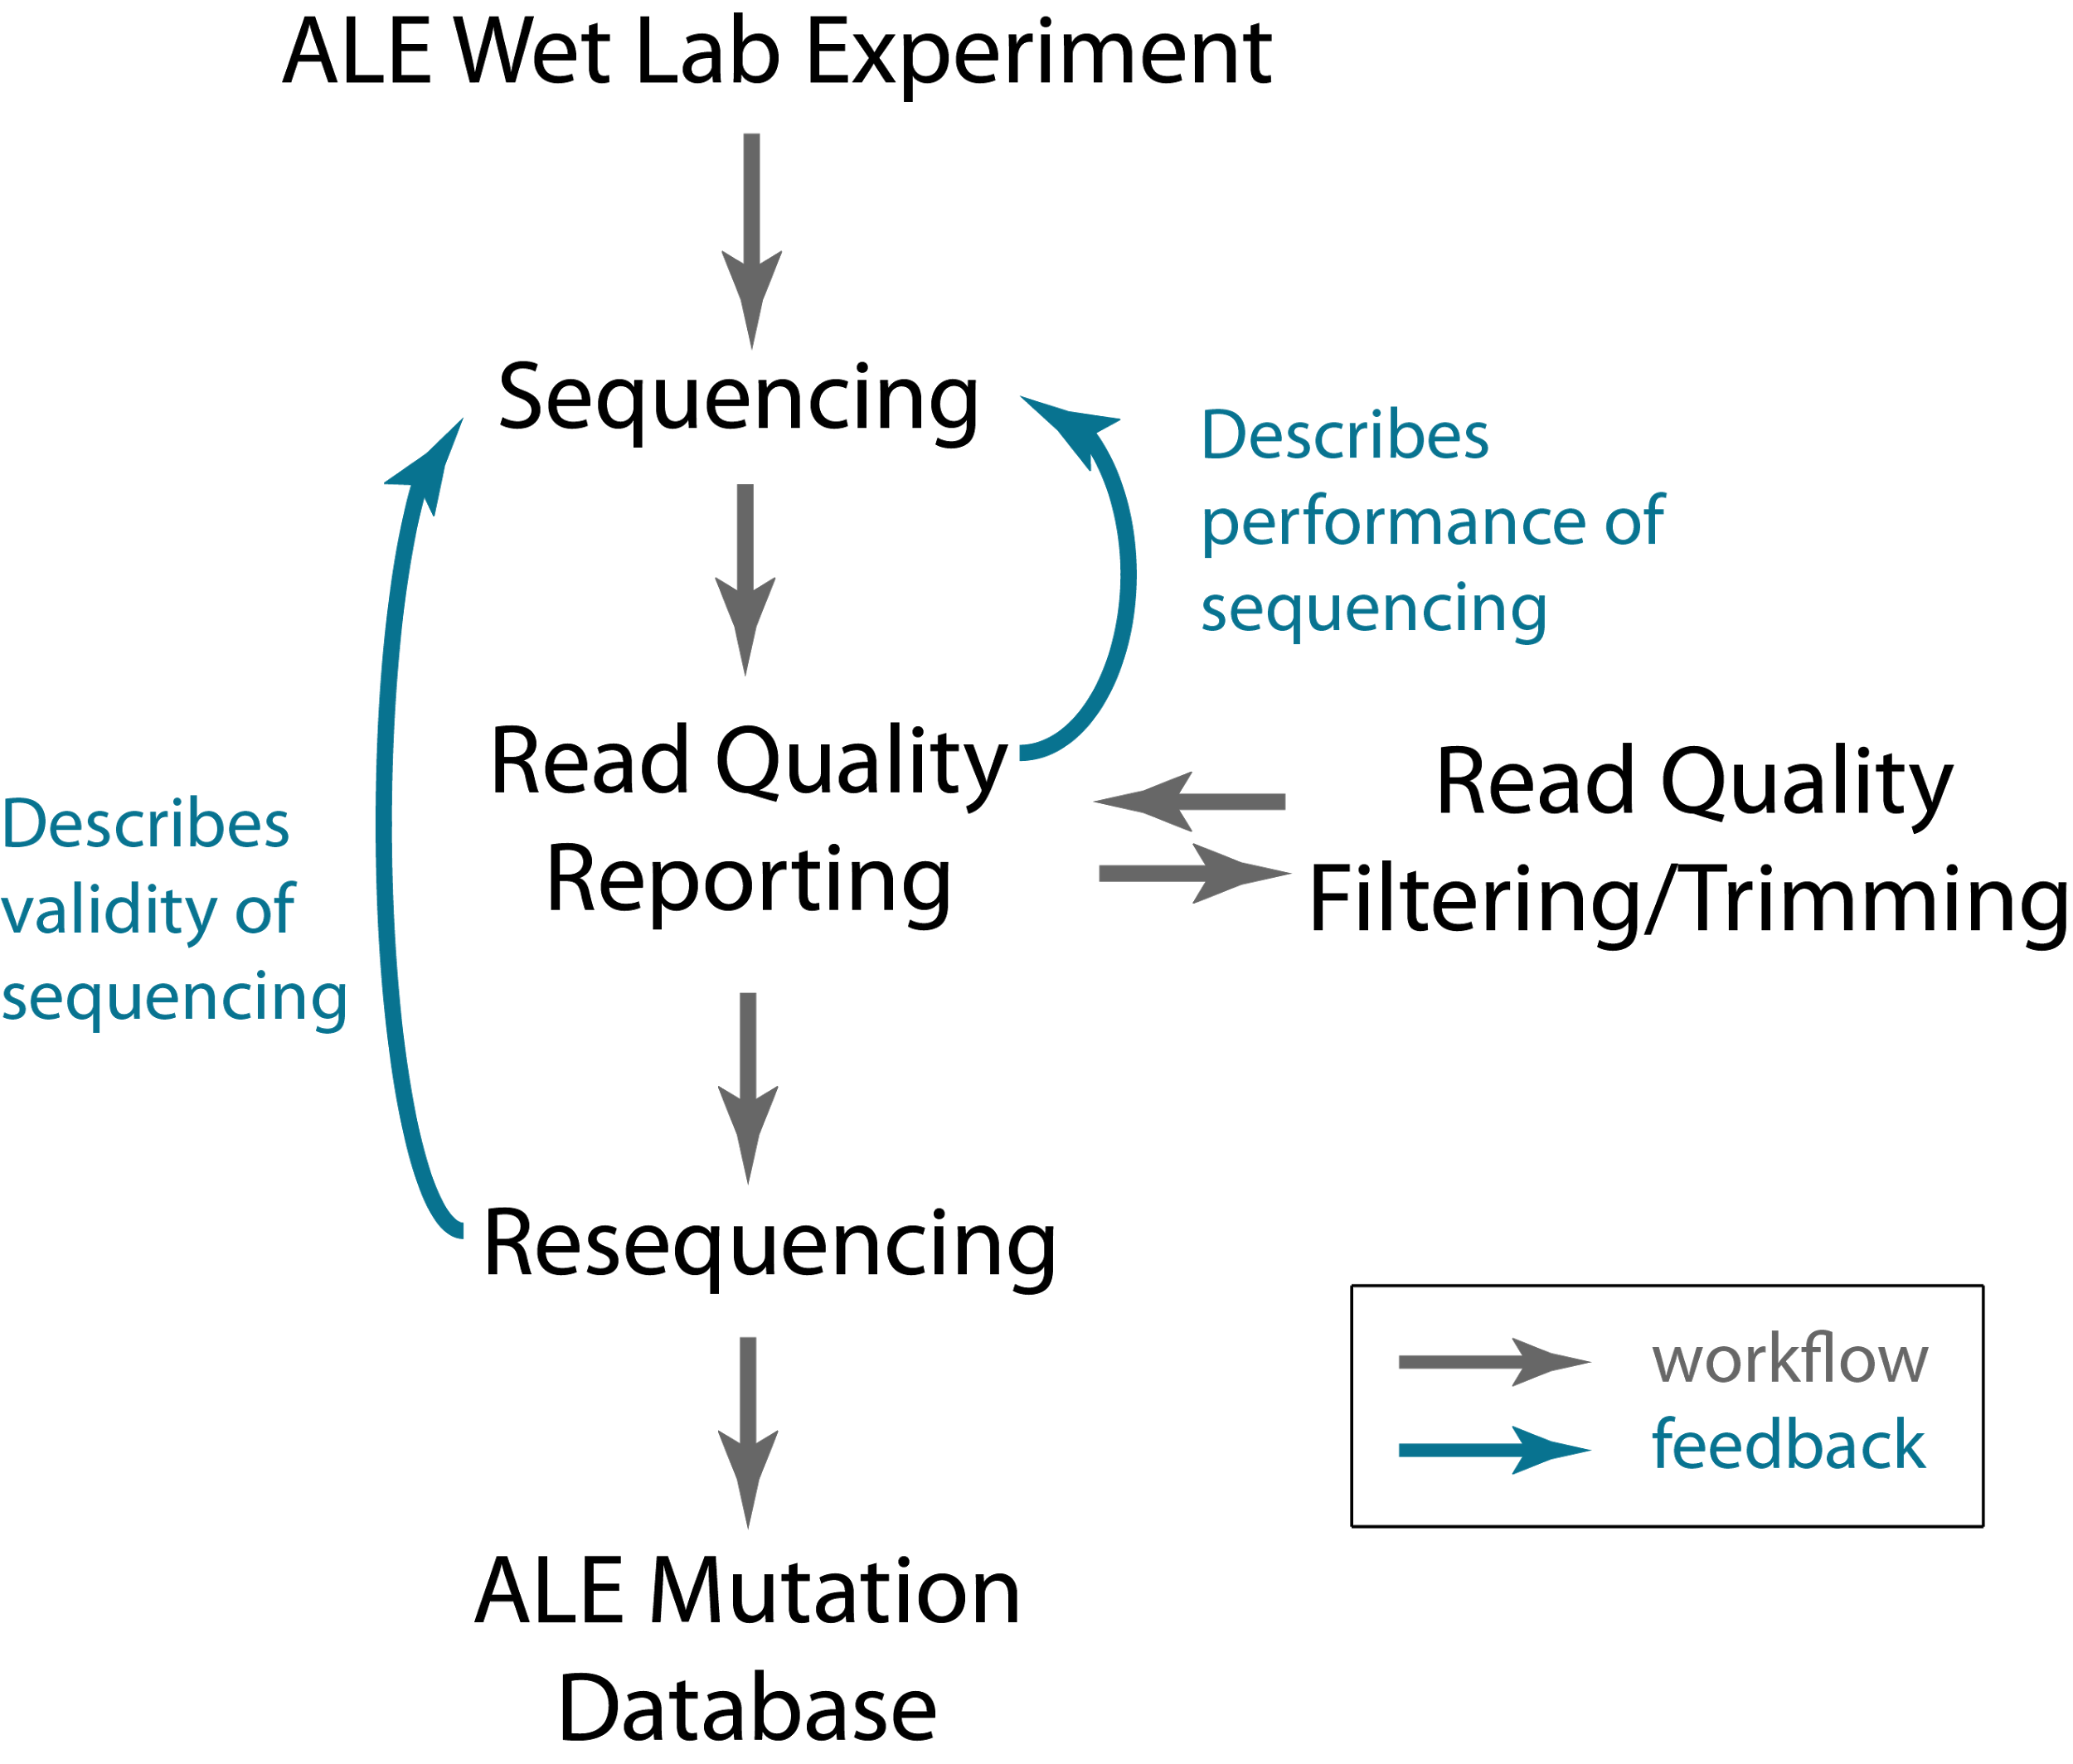
Aim 1: Contributions
Improve the quality of information output from the sequencer
Establish a toolset for generating mutation data.
Quick feedback for ALE sample preparation processes.
Notes:
In summary, we’ve researched and implemented a post-processing protocol that incorporates quality control methods and established mutation calling tools into our ALE operations.
This diagram illustrates the full post-processing protocol workflow.
Something subtle yet important to point out, which is included in this diagram, is that the steps in this workflow can be used to provide feedback on sample preparation processes, giving lab members the opportunity to tweak their processes to enable for the best quality sequencing data.
The major contribution of this work is that we now leverage a pipeline of tools for:
Improving the quality of information output from the sequencer
Established a toolset for generating mutational data.
And, we can now provide quicker feedback on the results of the sample preparation processes.
With our post-processing protocol, ALE experiments have more accurate results and the body of the consolidated ALE experiment data in our ALE mutation database is ultimately more refined.
artifacts that manifest in these reports before the final data is presented to an experimentalist, therefore saving time.

Slide 12
Big Data
Aim I
Global Quality Control
Establish a Post-Processing Protocol
Automate Data Consolidation and Accessible Report Generation
Aim II
Aim III
Analysis Effort, Consistency and Accuracy
Automate Common Analysis
Knowledge
Notes:
Now we’ll review Aim 2, which focuses on a solution for the challenge of data consolidation, experiment results reporting and accessibility.

Slide 13
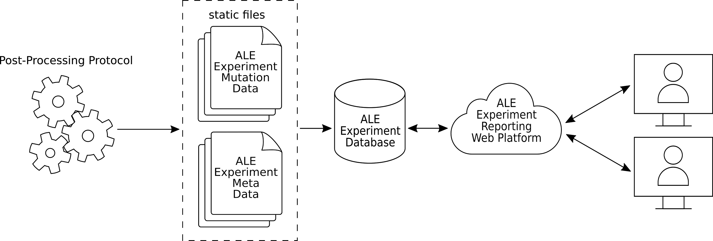
Aim II: Motivation and Workflow
ALE Experiment
ALE
Flask
Isolate
auto-generate reports
Big Data to Knowledge challenges
parse
× (big n) ⇒
consolidate
Notes:
Motivation
This aim IS THE primary solution to the previously mentioned Big Data to Knowledge challenge that now exists with our lab’s ALE operations.
ALE experiments are composed of multiple ALEs, each with multiple Flasks in which can be generated multiple isolates from.
Each isolate is a sample that we sequence and process using our POST-PROCESSING PIPELINE to investigate its mutations WRT the experiment’s starting sequence.
With the high-throughput ALE experiments enabled by the ALE Machine, the manual work of consolidating all the sample mutations into reports that describes the ADAPTIVE mutations of an experiment has become a PRIMARY bottleneck in the ALE operations.
The obvious solution here is to automate this process using software.
NEXT
We’ve built a software framework that will parse all incoming sample mutation data,
NEXT
consolidate them into a database
NEXT
and auto-generate web accessible reports for the ALE experiments.
Experimentalists will sort and report an ALE’s samples according to the chronological order of their flask and isolate to view mutation trends in the evolution. We can think of these reports as mutation lineages.

Slide 14
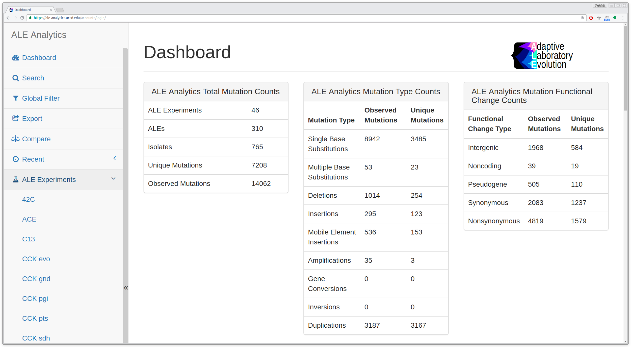
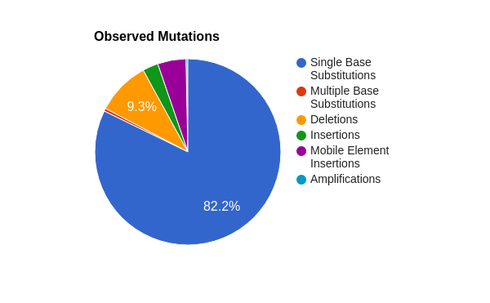
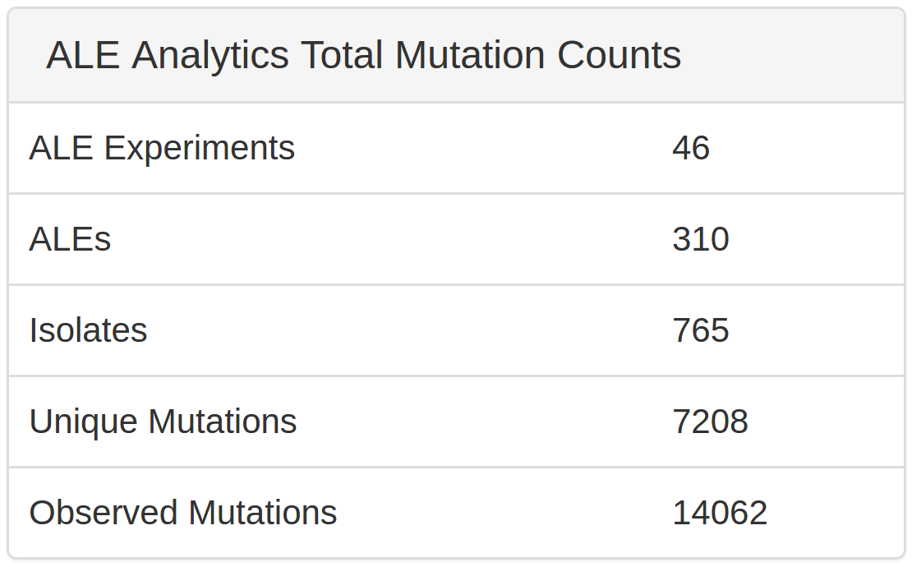
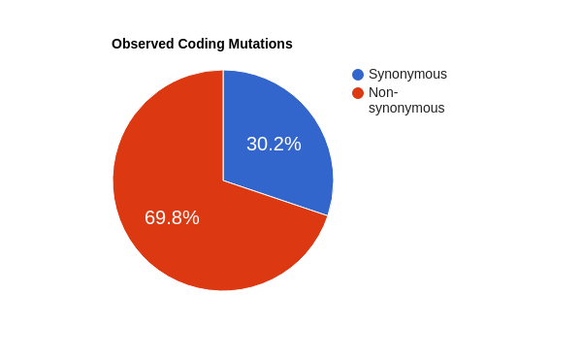
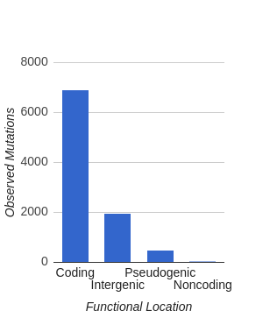
Aim II: ALE Analytics Web Platform (Results)
Notes:
Results
THIS effort has resulted in a platform we’ve named ALE Analytics, which now houses almost all of the lab’s ALE experiment mutation results. and AUTO-generates various reports for each ALE experiment.
NEXT
This screenshot gives a summary of the latest snapshot of the amount of ALE experiment components contained within the platform.
TALK TOWARDS THE LARGE AMOUNT OF ALE EXPERIMENTS AND OBSERVED MUTATIONS
NEXT
This consolidation has resulted in a very valuable database of ALE Experiment mutations.
NEXT
Of the mutations within the database, the majority are SNPs with the 2nd largest group being INDELs.
NEXT
The majority of our mutations are in CODING regions,
NEXT
Of the coding mutations, almost 70% of them are non-synonymous.
This database continues to grow with each new ALE experiment and is currently used for data mining mutational trends in evolution.

Slide 15
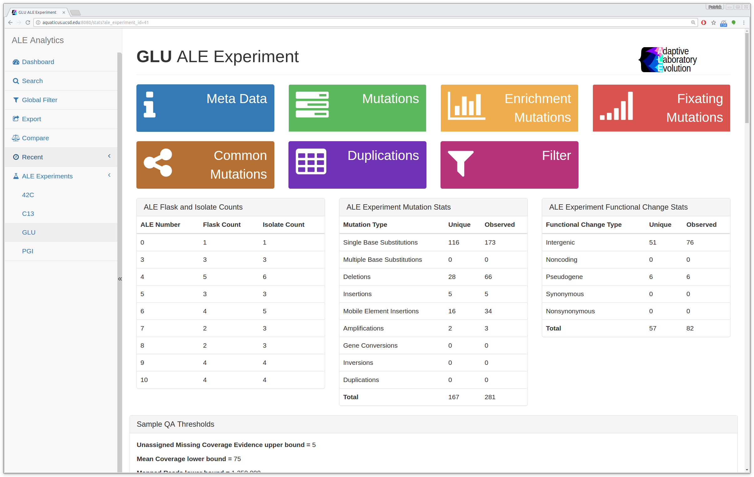
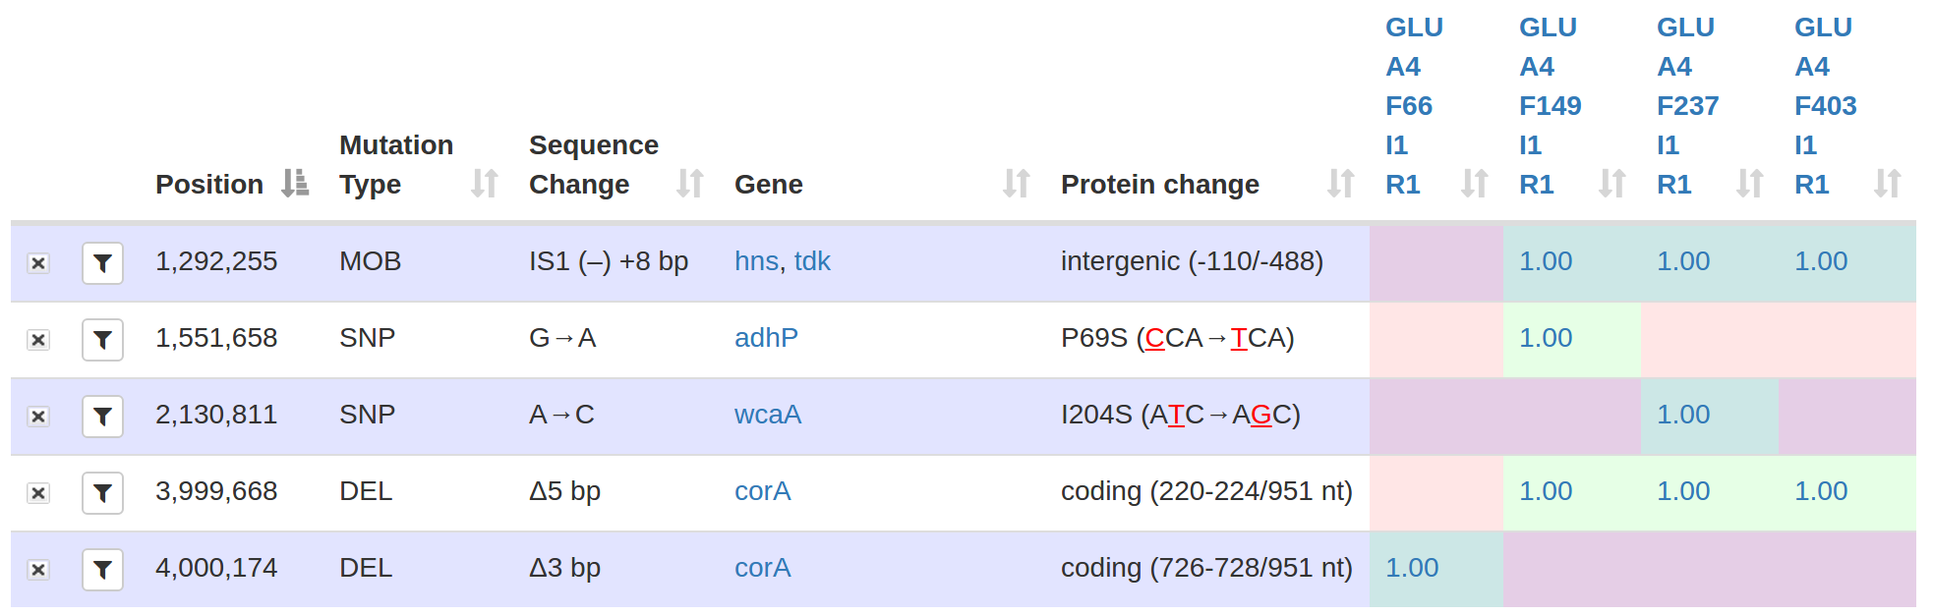
Aim II: ALE Analytics Web Platform (Results)
GLU Mutations
Mutation Lineage Reports
Notes:
Results
The INITIAL PRIMARY feature of ALE Analytics was to automate the generation of ALE Experiment mutation lineage reports.
With these reports, each column is a sample and each row is a mutation.
The occurrence of a mutation in a sample is annotated with a value in the corresponding cell. This value represents the approximate frequency of the sample population that the mutation was found in.
Samples are organized from left to right according to their chronological order within the ALE.
These reports are used by experimentalists to identify mutational trends in an evolution.
I’ll present more on this later, but within this example we can see 3 interesting trends.

Slide 16
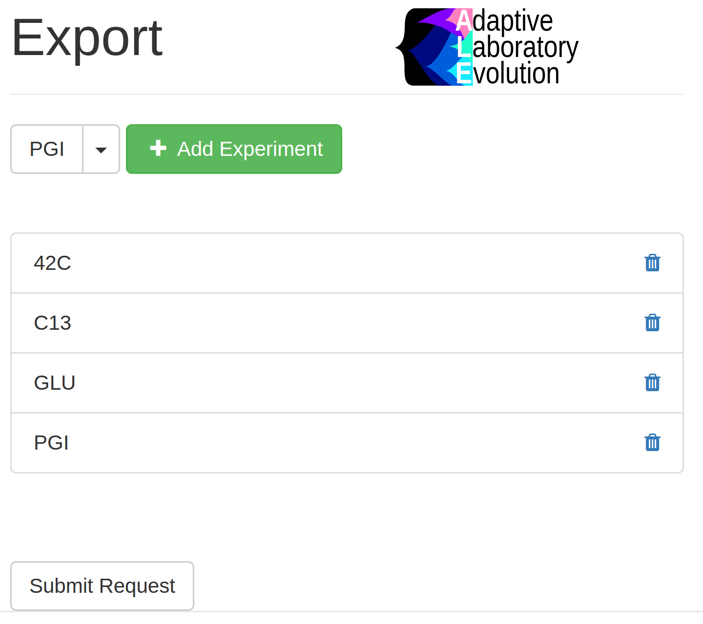
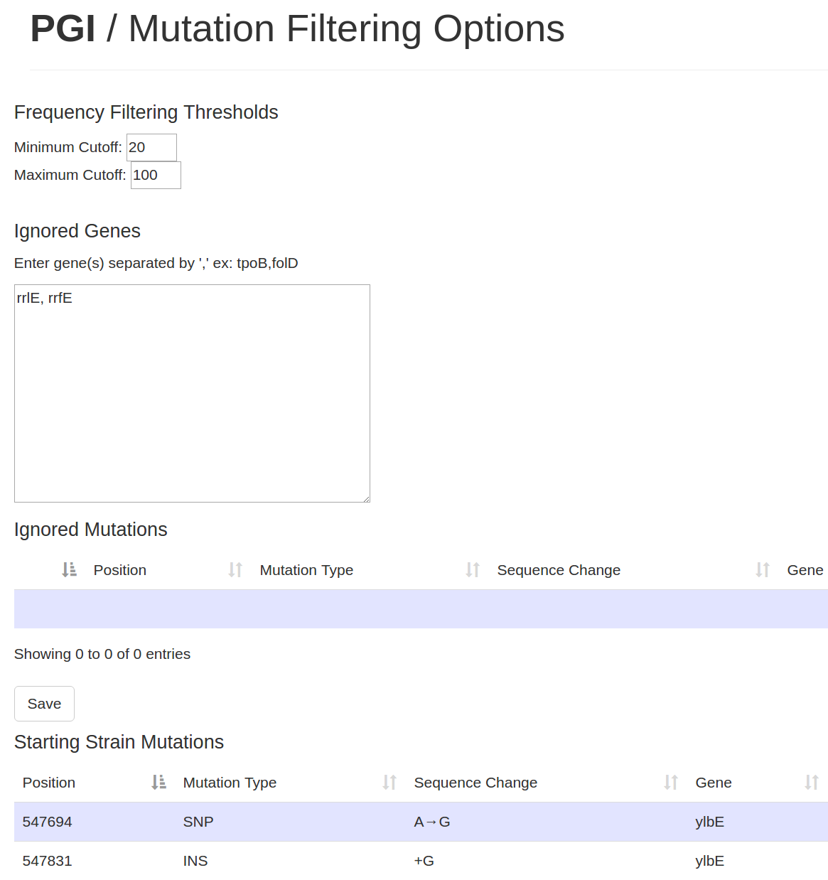
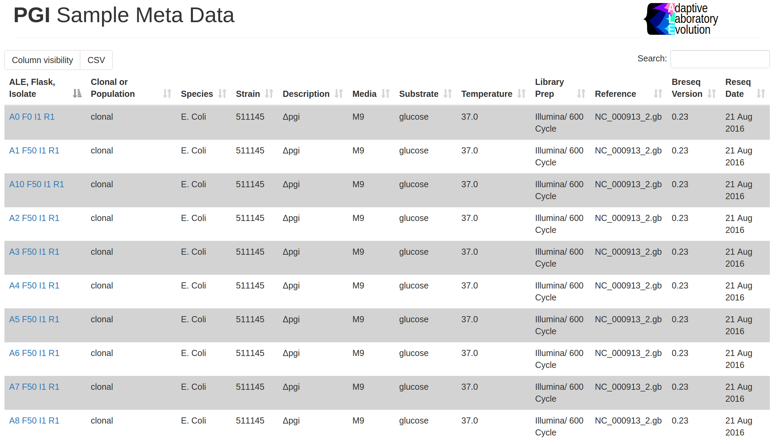
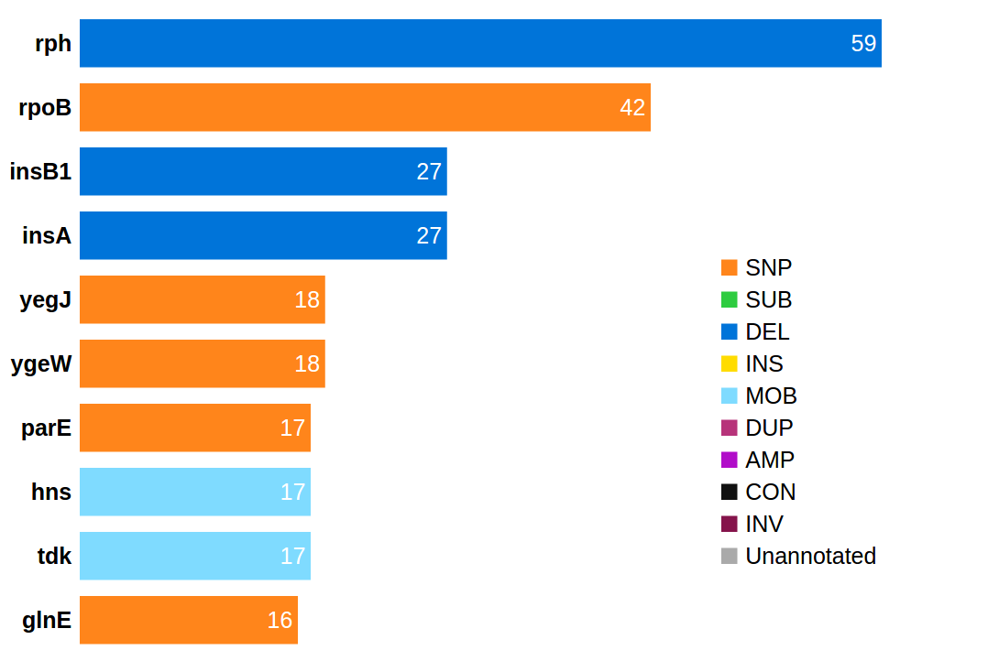
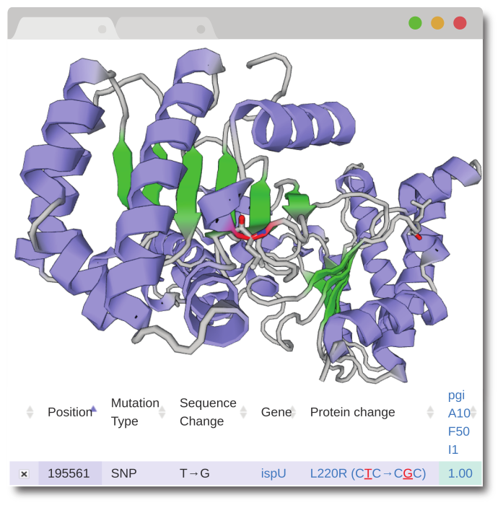
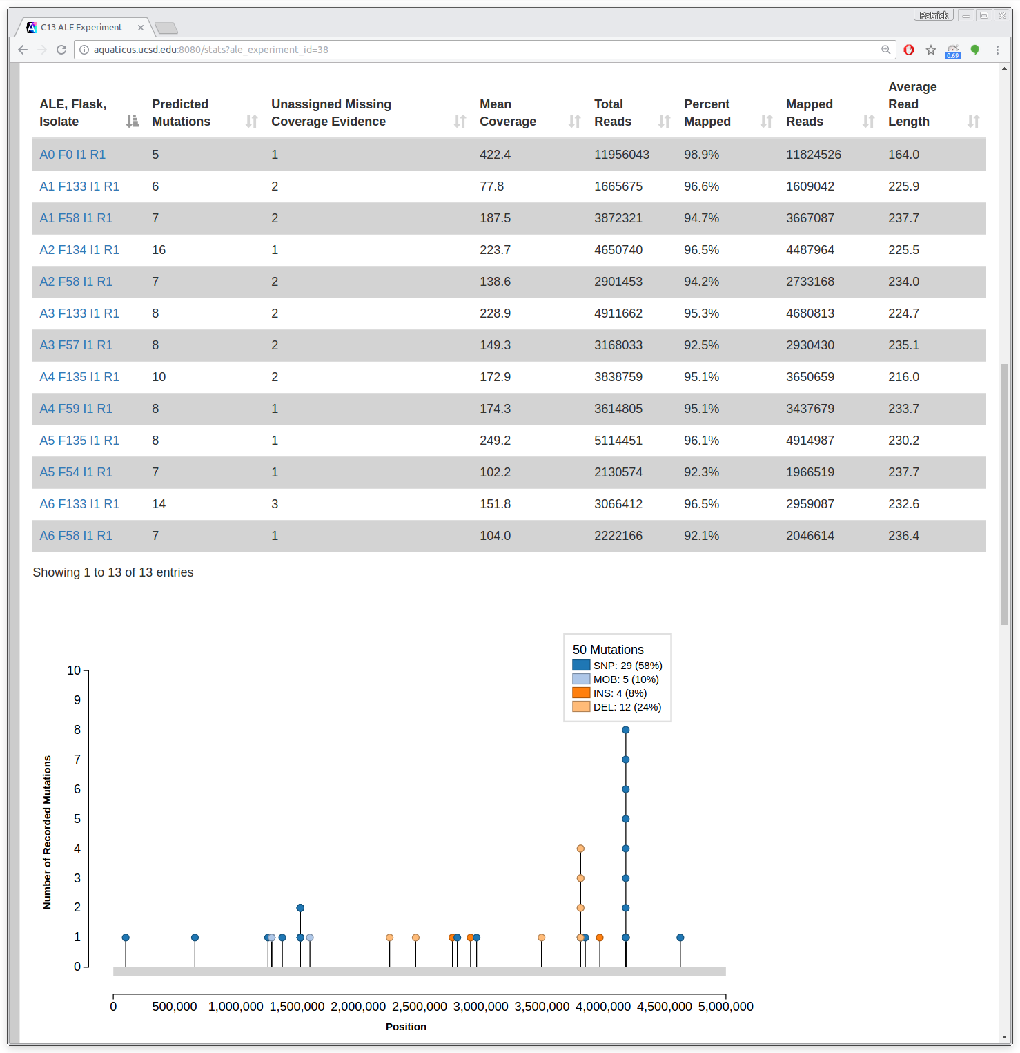
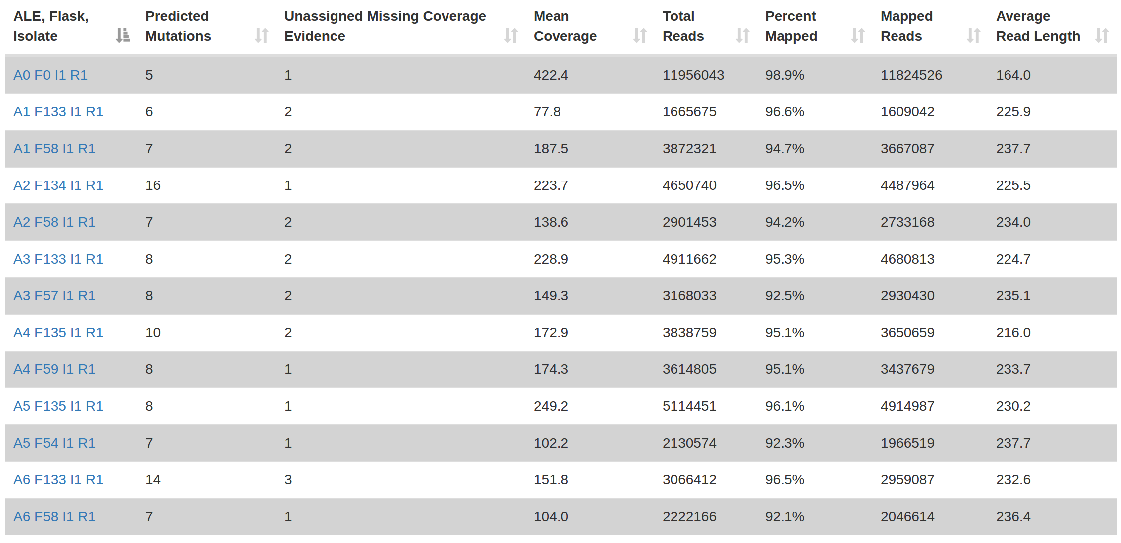
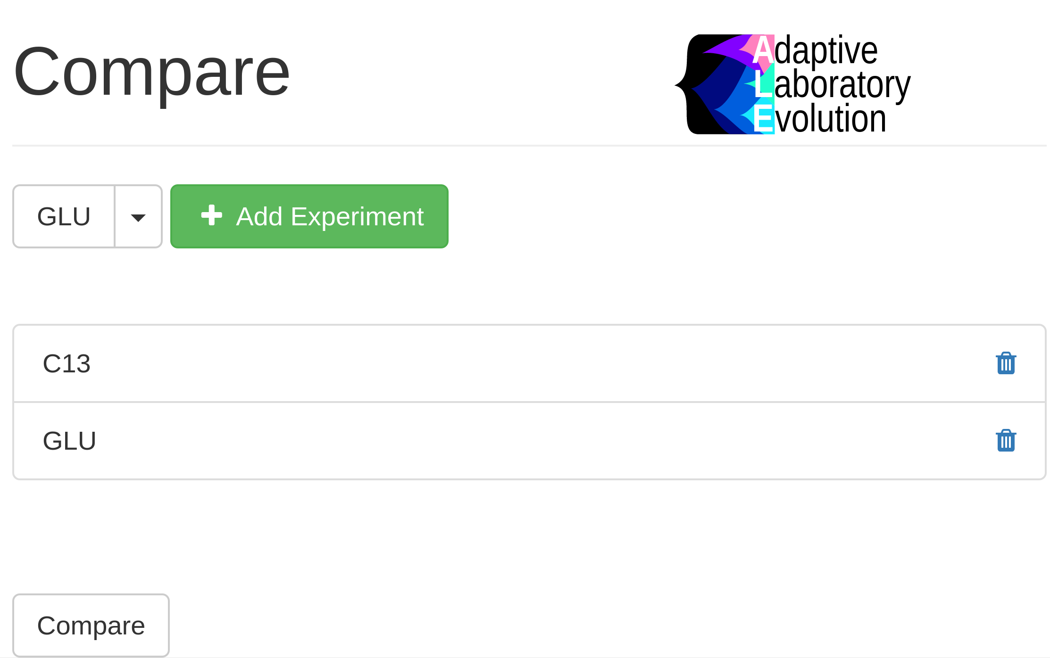
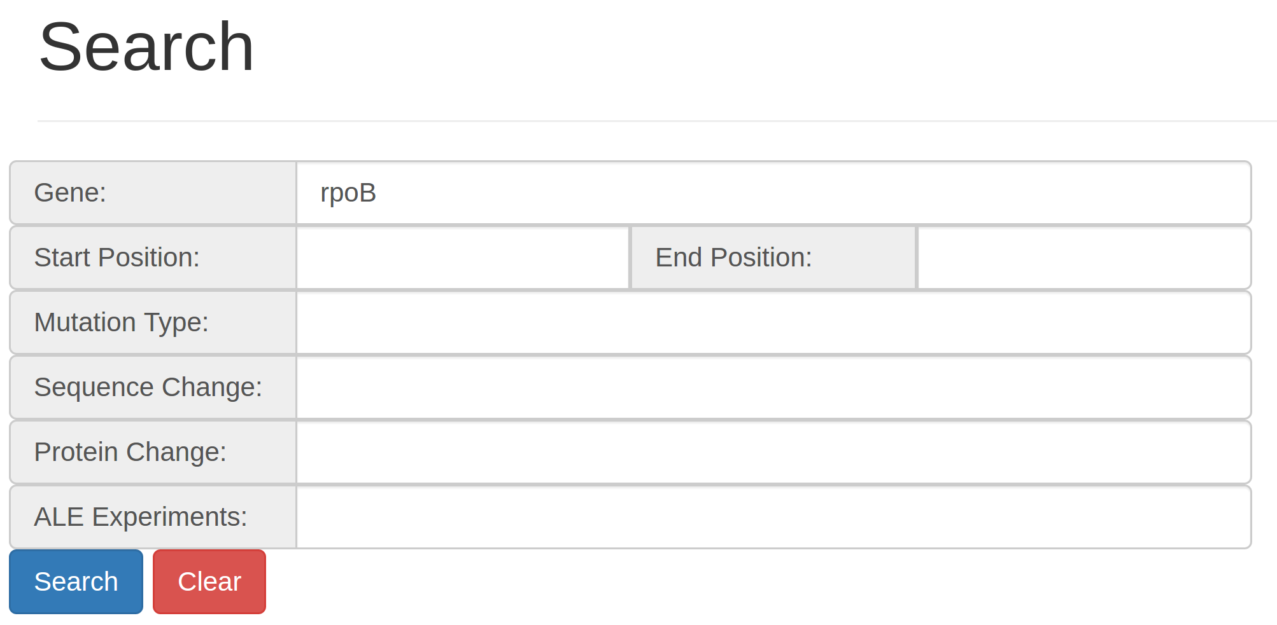
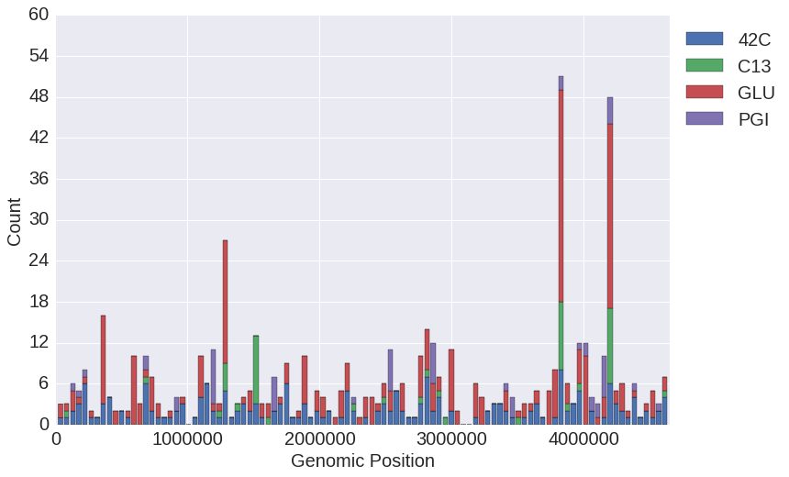
Aim II: ALE Analytics Web Platform (Results)
Gene mutation frequencies
Mutation needle plot
Mutation search
Mutation filtering
Experiment metadata reporting
Gene product structure mutation highlighting
Sample alignment performance reporting
Experiment auto-comparison
Experiment data export
Notes:
Through its development, the ALE Analytics platform has accumulated a large set of features that are meant to service the various dimensions ALE experiment analysis.
VISUALIZATION
For every ALE experiment and the whole database, we generate visualizations that describe the mutations found within.
One of these visualizations is a histogram of the most frequently mutated genes.
MUTATION NEEDLE PLOT
We also generate a mutation needle plot that can be used to visually identify mutation hotspots for an experiment.
SEARCH
We’ve also implemented a mutation search feature that will query the entire mutation database and return a report of mutations according to the search parameters given.
FILTERING
We’ve built mutation filtering into our report generation, where experimentalists can use a form to exclude mutations from an ALE Experiments reports.
METADATA REPORT
We generate metadata reports so users can be aware of the conditions associated with an experiment,
GENE PRODUCT STRUCTURE
Given enough information on a mutation, we can highlight the section of a gene PRODUCT’s 3D structure that a mutation affects
ALIGNMENT PERFORMANCE REPORT
We generate alignment performance statistics for each ALE experiment sample
EXPERIMENT AUTO-COMPARE
We even have a feature to auto-compare ALE Experiments by generating mutation lineage reports that combine samples of all selected ALE experiments.
EXPERIMENT DATA EXPORT
A forward thinking feature we’ve included is the ability to export ALE experiment mutation data as a flat file so that experimentalists can develop their own data-mining protocols to execute on one or more experiments.

Slide 17
Aim II: Contributions
Reduces the time and effort of consolidating experiment results and generating reports.
Result reports use a consistent format and are easy to compare.
Unify all ALE experiment reports results into one resource.
Enables the inclusion of more samples into ALE experiment‘s analyses.
Building the foundation for a future, publicly available, well curated adaptive mutation database.
Provides not just a protocol or toolset, but an analysis system and database that is continuously available to all collaborators and that doesn’t require programming of them.
Notes:
Contributions
The contributions of this effort is a service that
Reduces the time and effort of consolidating experiment results and generating reports. NEXT
AND, these reports use a consistent format and are easy to compare. NEXT
Unify all ALE experiment results into one resource. NEXT
Enables the inclusion of more samples into ALE experiment‘s analyses. NEXT
Building the foundation for a future, publicly available, well curated adaptive mutation database. NEXT
Provides not just a protocol or toolset, but an analysis system and database that is continuously available to all collaborators and that doesn’t require programming of them.

Slide 18
Big Data
Aim I
Global Quality Control
Establish a Post-Processing Protocol
Automate Data Consolidation and Accessible Report Generation
Aim II
Aim III
Analysis Effort, Consistency and Accuracy
Automate Common Analysis
Knowledge
Notes:
We’ll now review Aim 3, which focuses on finding a solution for better accuracy and consistency of analysis with less effort.

Slide 19
Aim III: Motivation
GLU Mutations
Mutation Lineage Reports
Key mutations
Notes:
Motivation
Experimentalists begin their investigation of ALE experiments by searching for interesting mutation trends in their samples.
NEXT
These trends currently focus on a high frequency mutation’s within an ALE experiments.
NEXT
Or a gene mutated many times within an ALE Experiment.
The process of finding these interesting mutational trends or key mutations can be also be automated.
First, I’ll review the terminology given to these key mutation trends.

Slide 20
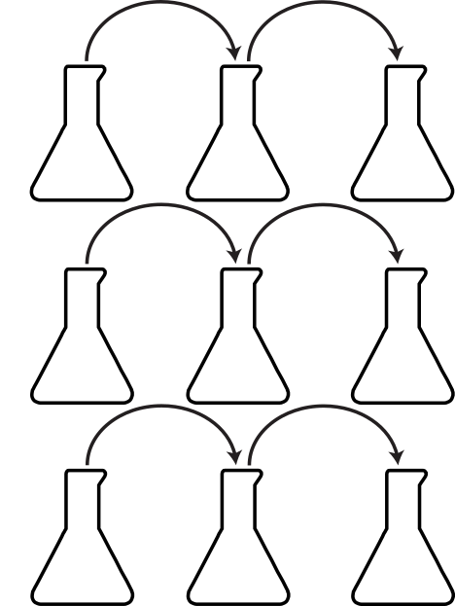
Aim III: Enrichment Mutation Analysis (Workflow)
Mutations enrich gene A.
ALE 1
A
ALE 2
A
B
ALE 3
Notes:
Workflow
The first is the analysis of what I call Enrichment Mutations.
To clarify, we’ve termed enrichment mutations as those sets of 2 or more mutations that affect the same gene in an ALE experiment.
This can happen in different ways.
A gene can be mutated in multiple endpoints of an ALE.

Slide 21
Aim III: Enrichment Mutation Analysis (Workflow)
Mutations enrich gene A.
ALE 1
ALE 2
A
A
B
ALE 3
Notes:
Workflow
You can also have a gene mutated many times in the same ALE.

Slide 22
Aim III: Enrichment Mutation Analysis (Workflow)
Mutations enrich gene A.
ALE 1
ALE 2
C
A
B
ALE 3
A
Notes:
Workflow
Additionally, it doesn’t matter if the gene is only mutated in the middle of an ALE for the enrichment analysis, since populations containing beneficial mutations can often get overtaken by more fit populations that may not share the same mutations.
With the Enrichment Mutation analysis, we’re ultimately looking for genes that are mutated many times in an ALE experiment and we auto-generate a report very similar to that of the Mutation Lineage report that present ONLY these mutations.

Slide 23
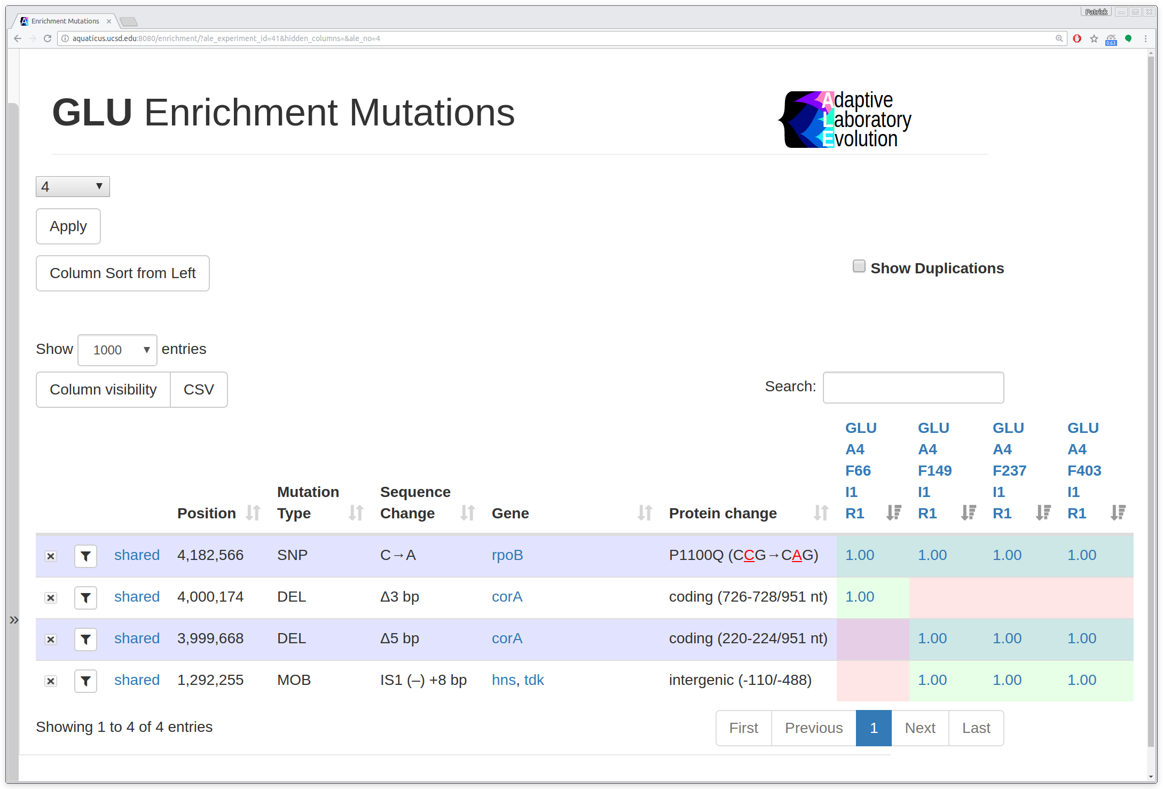
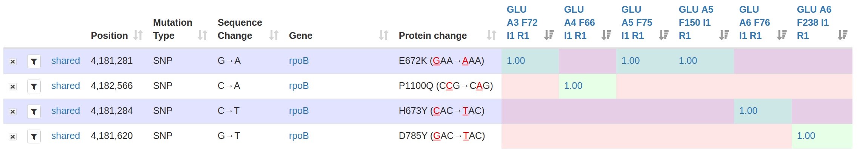
Aim III: Enrichment Mutation Analysis (Workflow)
Enrichment Mutation Report
Notes:
This is an example of an abbreviated Enrichment Mutation Report.
All genes reported in the Enrichment Mutation analysis are mutated more than once within an ALE experiment.

Slide 24

Aim III: Fixed Mutation Analysis (Workflow)
Mutation U fixes
ALE
U
U
Mutations U and V fix
ALE
U
U
U
V
V
Mutation V fixes
ALE
U
U
V
W
V
Notes:
Workflow
The second automated analysis looks for mutations that fix, or appear and persist in all subsequent samples of a unique ALE.
I’ve termed these fixed mutations.
TALK TOWARDS
In this case, mutation V would only get identified as a fixed mutation since it’s the only one to persists in multiple flasks to the end of the ALE, though mutation U would be identified as important by the enrichment mutation analysis, since these automated analysis occur and report in parallel.

Slide 25
Aim III: Ascending Freq Fixed Mutation Analysis (Workflow)
Mutation frequency equal to or larger than previous
ALE
30%
70%
100%
Mutation frequency descends
ALE
30%
70%
20%
Notes:
We’ve also implemented a filtering option into the fixed mutation analysis that will disregard any fixing mutation sequences which have a frequency trend that descends at some point in their series.
This is implemented to enable experimentalists to prioritize the fixing mutations they investigate.

Slide 26
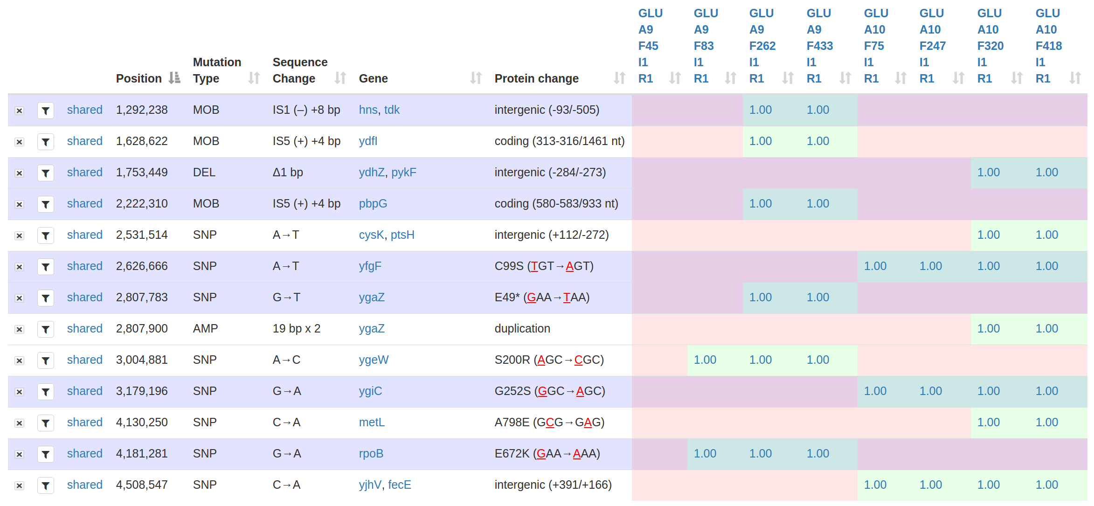
Aim III: Fixed Mutation Analysis (Workflow)
Fixed Mutation Report
Notes:
This is an example of an abbreviated Fixed Mutation Analysis Report; All mutations shown here are those that fix within a unique ALE of an experiment.
These automated analysis are the combination of methods that were used in identifying key mutations in many of the published ALE experiments by the System’s Biology Research Group.
They are relatively simple and are executed in some form for all ALE experiments. The value of their automation is best appreciated with large scale ALE experiments that include hundreds of mutations.

Slide 27
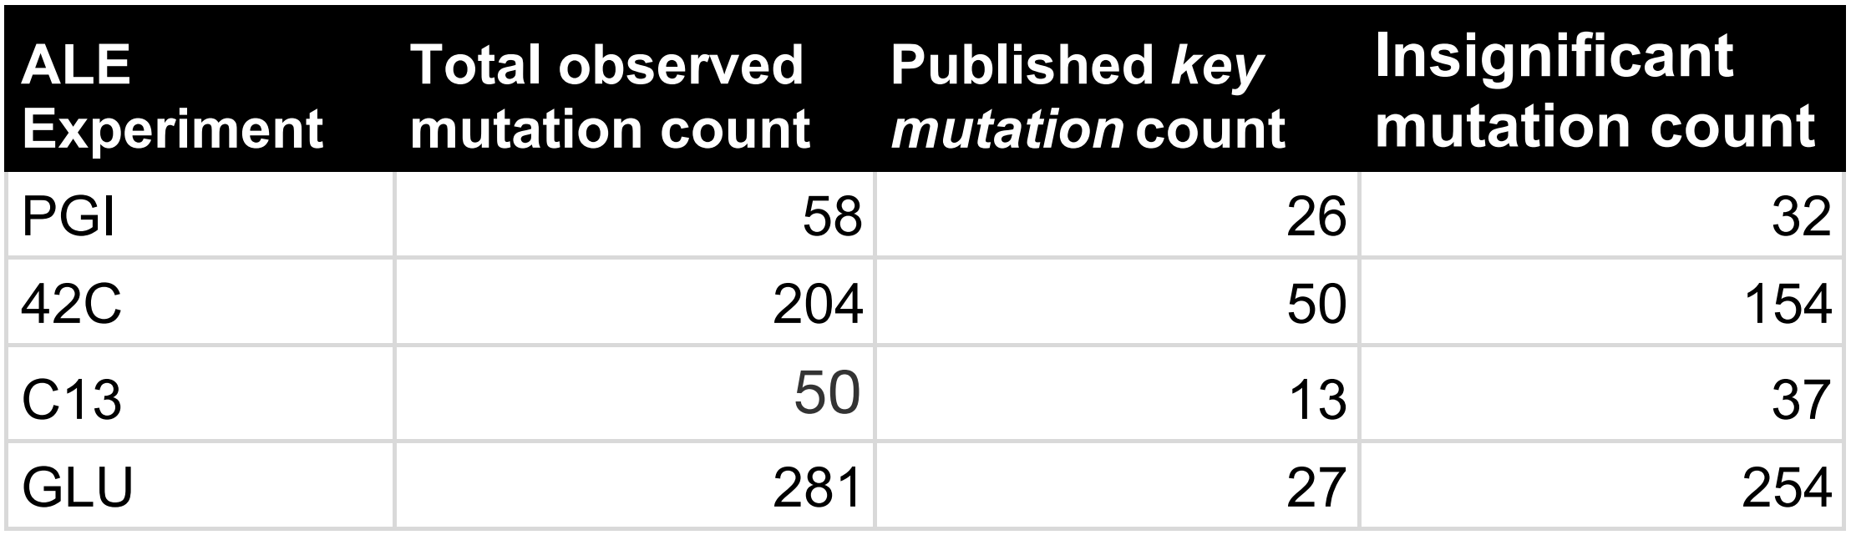
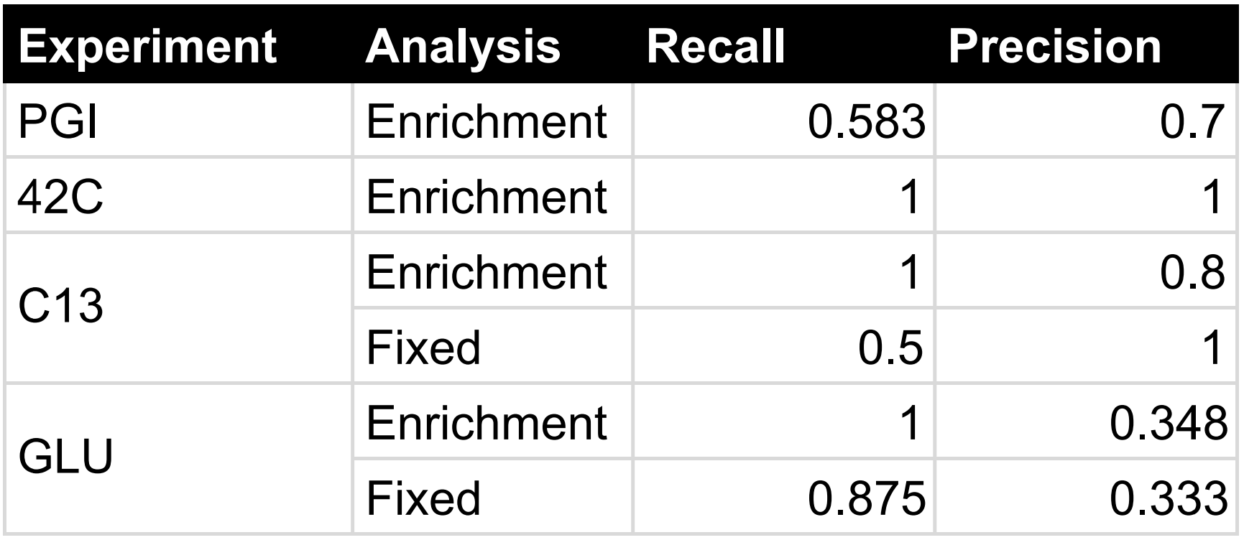
Aim III: Evaluation (Results)
Recall: performance in finding all True Positives.
Precision: performance in avoiding False Positives.
1
2
3
4
Overlooked Key Genes 42C²: yjiT GLU⁴: wecA
1
2
3
4
(1) Charusanti et al., PLoS Genet 2011
(2) Sandberg et al., PLoS ONE, 2016
(4) LaCroix et al., Appl. Environ. Microbiol., 2015
(3) Sandberg et al., Mol. Biol. Evol., 2014
Notes:
We also evaluated the automated analysis performance in finding the key mutations of published experiments.
We used 4 published ALE experiments For ease of reference, we refer to them as the PGI, 42C, C13 and GLU ALE Experiments.
NEXT
Key Mutations finding is essentially a classification task. The papers clarify that there exists an imbalance between non-significant and significant mutations counts in experiments.
We therefore chose the performance metrics Recall and Precision since the Accuracy metric can be biased by this imbalance.
Recall describes how well the automated analysis were able to report the full set of published key mutations
Precision describes how many additional mutations not reported as significant by the papers were included in the returned set.
NEXT
The automated analysis performance was generally acceptable.
For the ENRICHMENT MUTATION ANALYSIS
We generally experienced good RECALL. We had low RECALL in the PGI experiment due to the author taking into account experimental conditions and the known functions of singly mutated genes. We intend on incorporating future automated analysis that will realize this connection and report them as well.
Instances of lower PRECISION in PGI, C13 and GLU were often due to the combination of methods in identifying key mutations that hadn’t previously overlapped in the types of results they return.
For the FIXED MUTATION ANALYSIS:
PGI and 42C did not include any midpoint samples, therefore not including data to establish series of fixed mutations; we therefore couldn’t analyze the experiments with the Fixed mutation analysis.
The low RECALL of the C13 experiment was due to this experiment including very few midpoints samples, therefore not providing enough data to establish fixing mutations.
Instance of poor precision can in fact represent an opportunities to review these new key mutations for their additional fitness benefits.
Current and future ALE experiments being executed contain many more midpoint samples; we expect that the Fixed Mutation analysis will become much more important with more recent ALE experiments.
NEXT
Our automated analysis additionally identified genes affected with key mutation that were appropriately aligned with the methods of their respective papers, though had not been included in their publications.
These omissions serves to demonstrate the importance of automating these analyses.

Slide 28
Aim III: Contributions
Reduces the time and effort in identifying significant mutation trends
Enables more accurate results by avoiding human error in analysis
Enables the comparison of different ALE experiment key mutation results by avoiding inconsistent analysis protocols between experimentalist.
Enables the automatic amendment of results for previously analyzed experiments.
Notes:
Contribution
The contributions of this effort is a service that
NEXT
Reduces the time and effort in identifying significant mutation trends
NEXT
Enables more accurate results by avoiding human error in analysis
NEXT
Enables the comparison of different ALE experiment key mutation results by avoiding inconsistent analysis protocols between experimentalist.
NEXT
Something that we didn’t plan for but has served us well in development is that automating the analysis enables the automatic amendment of results for previously analyzed experiments.

Slide 29
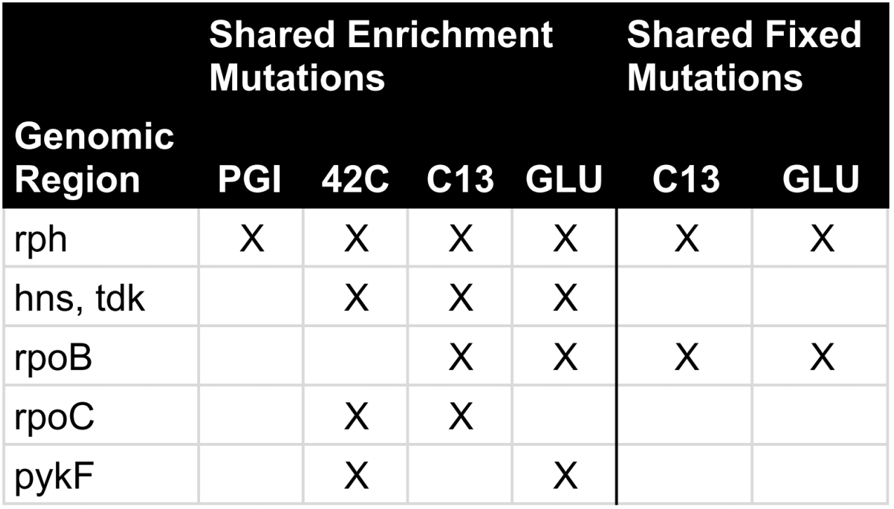
Leveraging the Database
Shared Fixed and Enrichment Genomic Regions
rph: general optimization over parent strain
hns/tdk, rpoB and rpoC: affecting global transcription regulation.
pykF: disabling phosphoenolpyruvate for better glucose uptake.
Notes:
The majority of my effort up to this point has been to establish this system and get it robust enough so that our collaborators can use it with their ALE experiments, though I’ve begun to developed features that take advantage of the valuable mutation database.
NEXT
I’ve developed a feature named shared key mutations that reports all of the enrichment and fixed mutations sharing GENOMIC REGIONS among multiple experiments. and the conditions in which those mutations manifested in through combined metadata reports.
With this feature we see that there are a particular set of genomic regions that are mutated across many of the published ALE experiments used in our evaluation.
rph is found to be mutated by key mutations in all evaluation experiments. The mutation of this gene seems to be a general optimization from the parent strain of these experiments.
hns/tdk, rpoB and rpoC are also affected by key mutations in multiple experiments. Mutating these genes benefits growth rate by affecting global transcription regulation within the experimental conditions.
pykF was affected by key mutations in two experiments with a high availability of glucose. The mutation of this gene has been associated with enabling an increase in uptake of glucose by reducing or disabling the metabolism of phosphoenolpyruvate.

Slide 30
Conclusion
We have developed a software system that addresses each challenge that defines the Big Data to Knowledge solution for ALE operations.
post-processing protocol to generate mutation data and impose quality control.
software framework for the parsing and databasing of experiment results
deployed a web app for accessible report auto-generation.
automated common key mutation analysis for better accuracy and consistency of results with less effort.
We evaluated the automated common analysis and reasoned acceptable performance.
Mining the database for significant trends.
Notes:
In conclusion, We have developed a software system that addresses each challenge that defines the Big Data to Knowledge solution for our ALE operations. NEXT
In this, we established a post-processing protocol to generate mutation data and impose quality control.
We’ve developed a software framework for the parsing and databasing incoming mutation data
and deployed a web app for auto-generation of accessible reports.
We’ve automated common key mutation analysis for better accuracy and consistency of analysis with less effort.
We also evaluated the automated common analysis and reasoned acceptable performance. NEXT
And finally, we recognize the the value of the consolidated ALE mutation data and have started efforts in its datamining.
ALE Analytics has culminated in a platform that supports the multitude of services experimentalists currently need to execute their ALE experiment analysis and represents an important opportunity as a source of future novel discovery.

Slide 31





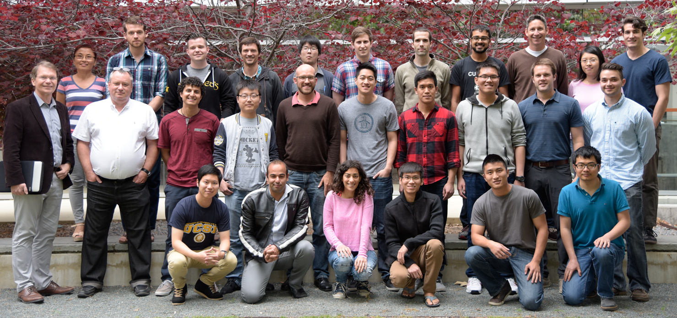







Acknowledgements
Dr. Bernhard Palsson
Dr. Adam Feist
Dr. Ryan LaCroix
Troy Sandberg
Gabriela Guzman
Joon Ho Park
Douglas McCloskey
Dennis Gosting
Dr. Ali Ebrahim
Notes:
Dr. Palsson and Dr. Feist for championing this project.
I’d like to thank the ALE team for all of the help.
I’ve had the privilege of partnering with an overall great undergrad, Dennis Gosting. He’s contributed and authored a significant amount to the front-end features we had previously reviewed.
I thank Dr. Ebrahim for his early work on prototypes of ALE Analytics.
I have been lucky enough to be financially supported throughout my work on this project; I would like to thank the System’s Biology Research Group and the Novo Nordisk Foundation Center for Biosustainability for funding my research and the opportunities to present this work at conferences.

Slide 32
Supporting information

Slide 33
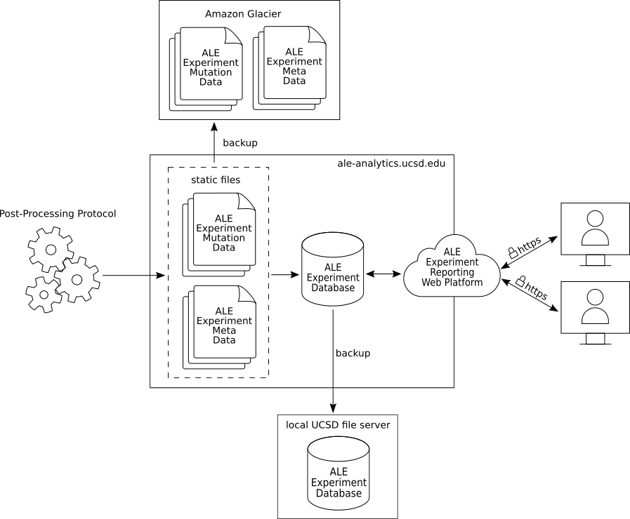
Aim II: ALE Analytics Web Infrastructure (Results)
Notes:
Being that our intentions are to develop a platform that will continue to grow and serve users in a professional research environment, we’ve invested substantial efforts in data backups and security.
There are two bodies of data that need to be backed-up:
The static files generated from the post processing protocol which now total up to 1.8 Terabytes of storage space
And the ALE Experiment mutation database.
We make use of the Amazon Glacier service to back up our static files, due to their competitive storage cost per gigabyte of a fraction of a cent per month per gigabyte.
The ALE Experiment mutation database has a small enough footprint to be stored on a local UCSD file server.
For security, we use an industry standard technology stack for web applications and only enable browsing of ALE Analytics over encrypted HTTPS protocol.

Slide 34
Sequencing quality scores measure the probability that a base is called incorrectly. With SBS (sequencing by synthesis) technology, each base in a read is assigned a quality score by a phred-like algorithm similar to that originally developed for Sanger sequencing experiments.
Introduction to Q Scores
The sequencing quality score of a given base, Q, is defined by the following equation:
Q = -10log10(e)
where e is the estimated probability of the base call being wrong.
Higher Q scores indicate a smaller probability of error.
Lower Q scores can result in a significant portion of the reads being unusable. They may also lead to increased false-positive variant calls, resulting in inaccurate conclusions.
As shown below, a quality score of 20 represents an error rate of 1 in 100, with a corresponding call accuracy of 99%.
Relationship Between Sequencing Quality Score and Base Call Accuracy
Quality Score | Probability of Incorrect Base Call | Inferred Base Call Accuracy
10 (Q10) | 1 in 10 | 90%
20 (Q20) | 1 in 100 | 99%
30 (Q30) | 1 in 1000 | 99.9%

Slide 35
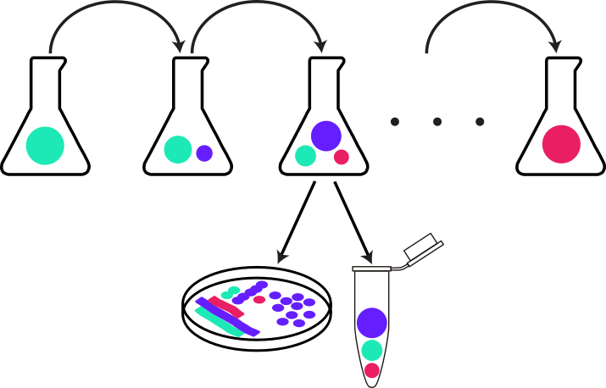
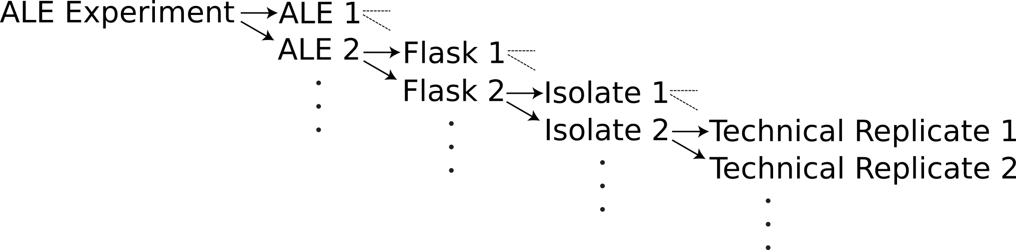
ALE
Isolates
Notes:
Two key points in the title I’ll first give some background on are:
Adaptive Laboratory Evolution Experiments
Microbial Genomic Data
Adaptive Laboratory Evolution (or A-L-E “ALE”) Experiments can be described more simply as experimental evolutions, where someone
Isolate an organism of interest in a controlled environment
Enable the organism to grow in the controlled environment for multiple generations of offspring.
What you see here is a sequence of multiple flasks representing an ALE; during an evolution, the environmental resources a population uses to grow need to be replenished. There are many ways of doing this; for ALE in particular, we accomplish this by passing a representative sample from a populated flask to a fresh flask with new media. We call that a “passage”
And finally, you Investigate the genotype of selected generations within the ALE.
This is accomplished by taking an isolate from a flask, processing this samples into a sequencing pipeline and observe the mutations that manifest during the experimental evolution. This is where the Microbial Genomic Data plays its role.
NEXT
In the System’s Biology Research Group, the group I’m accomplishing this work with, we organize ALE experiments as the following:
We have an ALE experiment
That can be comprised of multiple ALEs
ALEs can have multiple flasks
And one or more isolates can be generated from a flask.
As generations of offspring are produced, they accumulate genomic differences via mutations from their starting strain.
NEXT
Experimentalists additionally may be interested in introducing particular stresses on the organism during the experiment in the hopes of observing genotypic changes as a result of the stress.
As organisms grow and replicate, mutations occur in their DNA.
Most mutations are thought to have detrimental or no effect on an organism, though there is a chance that a mutation will confer a benefit to an organism relative to the rest of the population and experimental conditions.
These beneficial mutations are likely to get passed onto offspring of future generations, therefore having this mutation persist for multiple generations.
An experimental evolution can be used to identify these beneficial mutations in research towards understanding how an organism adapts to a stress.
ALE experiments therefore focus on mutations that confer fitness benefits.

Slide 36
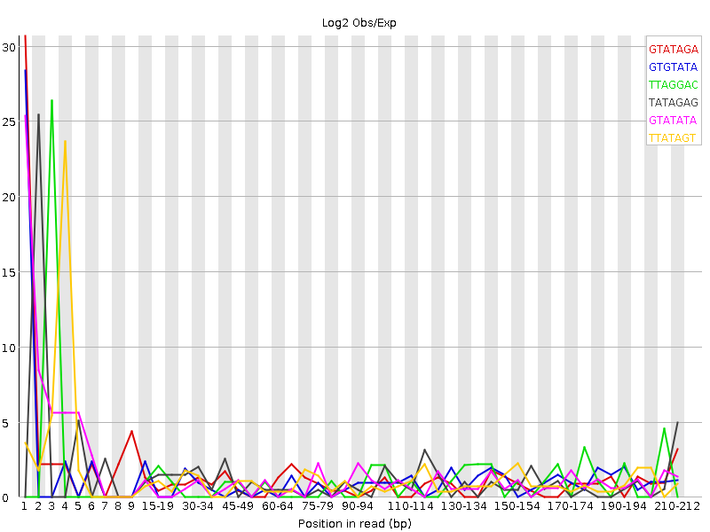
Aim I: Workflow
K-mer Bias
Base Bias Trimming
No Bias
Base Bias
Notes:
In some sample sets, we experienced a high frequency of mutations that manifested on the ends of reads, yet still maintained high Q-scores. Investigating the FastQC quality reporting, we are shown that our reads seem to express a bias in BASES and KMERS on their ends. This type of bias has been known to manifest with chemistry based shearing of an entire genome into smaller pieces.
NEXT
We therefore investigated trimming this bias and in some cases this helped.

Slide 37
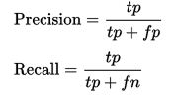
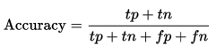

Slide 38
Backups

Slide 39
Leveraging the Database
Shared Enrichment and Fixed Mutations
External Data Mining Protocols
rph: general optimization over parent strain
hns/tdk, rpoB and rpoC: affecting global transcription regulation.
pykF: disabling phosphoenolpyruvate for better glucose uptake.
Notes:
The majority of my effort up to this point has been to establish this system and get it robust enough so that our collaborators can use it with their ALE experiments, though I’ve begun to developed features that take advantage of the valuable mutation database.
NEXT
I’ve developed a feature named shared key mutations that reports all of the enrichment and fixed mutations sharing GENOMIC REGIONS among multiple experiments. and the conditions in which those mutations manifested in through combined metadata reports.
With this feature we see that there are a particular set of genomic regions that are mutated across many of the published ALE experiments used in our evaluation.
rph is found to be mutated by key mutations in all evaluation experiments. The mutation of this gene seems to be a general optimization from the parent strain of these experiments.
hns/tdk, rpoB and rpoC are also affected by key mutations in multiple experiments. Mutating these genes benefits growth rate by affecting global transcription regulation within the experimental conditions.
pykF was affected by key mutations in two experiments with a high availability of glucose. The mutation of this gene has been associated with enabling an increase in uptake of glucose by reducing or disabling the metabolism of phosphoenolpyruvate.
NEXT
Our lab is very interested in data mining the ALE mutation database. It would be impractical to implement all the various data mining protocols in our software system.
The Experiment data export feature allows collaborators to pull some or all of the data from the ALE mutation database as flat files and use these files in their personal data mining protocols.
There has already been significant development in data mining the ALE mutation database. As an example, the figure shown here was generated by an external protocol and describes the topology of mutations from the PGI, C13, 42C and GLU experiments across their shared reference genome.

Slide 40

Aim I: Workflow
Read Quality Reporting: FastQC¹
Read Trimming: FASTX-toolkit²
Resequencing: Breseq³
(1) S. Andrews. Fastqc: a quality control tool for high throughput sequence data, 2010.
(2) Hannon Lab. FASTX Toolkit.
(3) Barrick et al. Methods Mol. Biol, 2014.
Notes:
Workflow
We’ve researched and implemented a post-processing protocol that incorporates quality control methods and established mutation calling tools.
The steps of the diagram on your left illustrate the post-processing workflow.
Something subtle yet important to point out is that the steps in the workflow can be used to provide feedback on certain ALE processes, giving the opportunity to tweak processing to avoid artifacts that manifest in these reports before the final data is presented to an experimentalist, therefore saving time.

